Slide 1
Library Management System Using C++
Presented by:
Abdul Malik
Muhammad Panah
Anum Abid
Manal Anwaar

Slide 2
Abstract
The system aims at the maintenance and management of the different libraries that are available in the different parts of the world. It mainly takes care of the library management at the core area of the database. The system provides the information on how many books are present in library, how many have been borrowed and how many books can be bought. The readers can use software and register themselves with the required information that is expected by the system.
The Library Management System is an application for assisting a librarian in managing a book library in a university. The system would provide basic set of features to add/update members, add/update books, and manage check in specifications for the systems based on the client’s statement of need.
Library management system is a typical management Information system its Development include the establishment and maintenance of back-end database and front-end application development aspects. For the former require the establishment of data consistency and integrity of the strong data security and good libraries. As for the latter requires the application fully functional, easy to use and so on.

Slide 3
TABLE OF CONTENT
Introduction
Aims and Objectives
Problem Statement:
Scope
Literature Review
Proposed Methodology:
Expectations of the Models Used
Flow chart
Out puts
GRAPH AND HISTOGRAM
Conclusion

Slide 4
Introduction
Library Management system is a software for monitoring and controlling the management in a library.
The project “Library Management System” is developed in C++, which mainly focuses on basic operations in a library like adding new books, updating information and searching books.
In this project librarian can arrange all the books conveniently to access them easily.

Slide 5
Aims and Objectives
To design, develop, and implement a library system that will speed up library transactions processes.
To design and develop a less time consumed in browsing the availability of the books.
To design and develop a computerized based system for faster and easier reports

Slide 6
Problem Statement
Librarians often find it difficult to arrange all the books in order.
The answer for this problem is the enhancement of technology by developing the Library Management System.
The efficiency of a library lies on how the books and other materials are arranged and how easily one can get the books of their choice. Generally, what we see nowadays is the manual library management system whose process of operation is very much hectic.
What we are doing is that we are proposing a computerized library management system, which provide better and efficient service to the library members.

Slide 7
Scope
The system will let the user to do the following:
Add Books.
Edit Books.
See all Books.
Delete a Book.
Limitations:
This Proposed system will not cover online reservation. The system is not a web-based.

Slide 8
Literature Review
Comparative features of integrated library management software systems (Namrata Rai, Shailendra Kumar, 2011)
Library automation with koha (R.A. Egunjobi, R.A. Awoyemi, 2012)
Impact of Library Automation in the Development Era (Shabana Tabusum, 2013)
Integrated Library Management Systems (ILMS) (Thuraiyappah Pratheepan, 2016)
Global library marketing research (Dinesh K. Gupta, B.M. Gupta, Ritu Gupta, 2016-2017)
Library Automation In Nigeria The Kenneth Dike Library Experience (Fataki, Olayinka C. , 2017)
University Library Management Based on Improved Collaborative (Yangdi Lia, 2018)

Slide 9
Literature Review Matrix
Limitations | Strength | Title | Author
NOT FOUND | To find out the hidden valueable information or some associations rules of a large amount of information in current library books management system | University Library Management Based on Improved Collaborative Filtering Association Rules Algorithm | Yangdi Lia, 2018
The resulting model has potential applications such as in the structuring analysis of academic library performance, mapping future directions of development and for exploring variations across the sector and internationally. | conceptualise the issues of alignment for changing academic libraries by using and extending McKinsey’s 7S model. | 7S model to understand strategic alignment in academic libraries | McKinsey, 2018
The paper provides a helpful inspiration for Big Data mining and software development, which will improve their efficiency and insight on users’ behavior and psychology. | The paper proposes a framework to help users understand others’ behavior, which will aid them better take part in group and community with more contribution and delightedness. | Library personalized recommendation service method based on improved association rules | Kaigang Yai, 2017

Slide 10
NOT FOUND | The task of evaluating integrated library systems is necessary to choose the most appropriate library management system that will answer the needs of the library in automating its operations | Integrated Library Management Systems (ILMS) - Open Source and Commercial Software | Thuraiyappah Pratheepan, 2016
The major obstacle to library automation in Nigeria has been poor funding. This paper is an eye opener. | Library automation will address the problem of manual processing of materials. It will further mean less drudgery. | Library automation with Koha | R.A Egunjobi, R.A. Awoyemi, 2012
In spite of the efforts by the Kenneth Dike library system in the past ten years to establish itself in the forefront of library automation in Nigeria and keep abreast of developments in the application of ICT to library services and operations. | Project planning and control determines to a very large extent the success of any project. Automation however, is a project that requires careful planning close monitoring of progress, failures.; an~ new challenges | Library Automation In Nigeria The Kenneth Dike Library Experience | Fataki, Olayinka C. , 2017
This article is based on a case study of library automation at the University of Botswana. The results may not therefore be widely replicated. Besides, the article did not delve deep into technology acceptance and diffusion of innovation issues that could illuminate further the case study. | This article is based on practical experiences of library automation at the University of Botswana and its impact on services, and human and physical resources. Previous studies on this subject at the university only covered migration from one system to another and the technical perspectives of the process of library automation. This study is broad in scope covering both technical and managerial processes of managing change in the context of library automation at the University of Botswana. | Library automation in sub Saharan Africa: case study of the University of Botswana | Stephen Mudogo Mutula, 2012

Slide 11
Proposed Methodology
The project library management system is targeted towards the management of a modern library.
Proper management of books are possible through an easy to interface for the library staff.
The proposed library management system in this proposal will be computerized management system developed to maintain all the daily work of library.

Slide 12
Main modules
Book management: to manage the books in the issue and also the reference sections, their classification, department wise distribution, single title calculations etc.
Reporting: several reports in different formats will be prepared and submitted to the respective authorities. Every user would be able to find out their historical point of view.

Slide 13
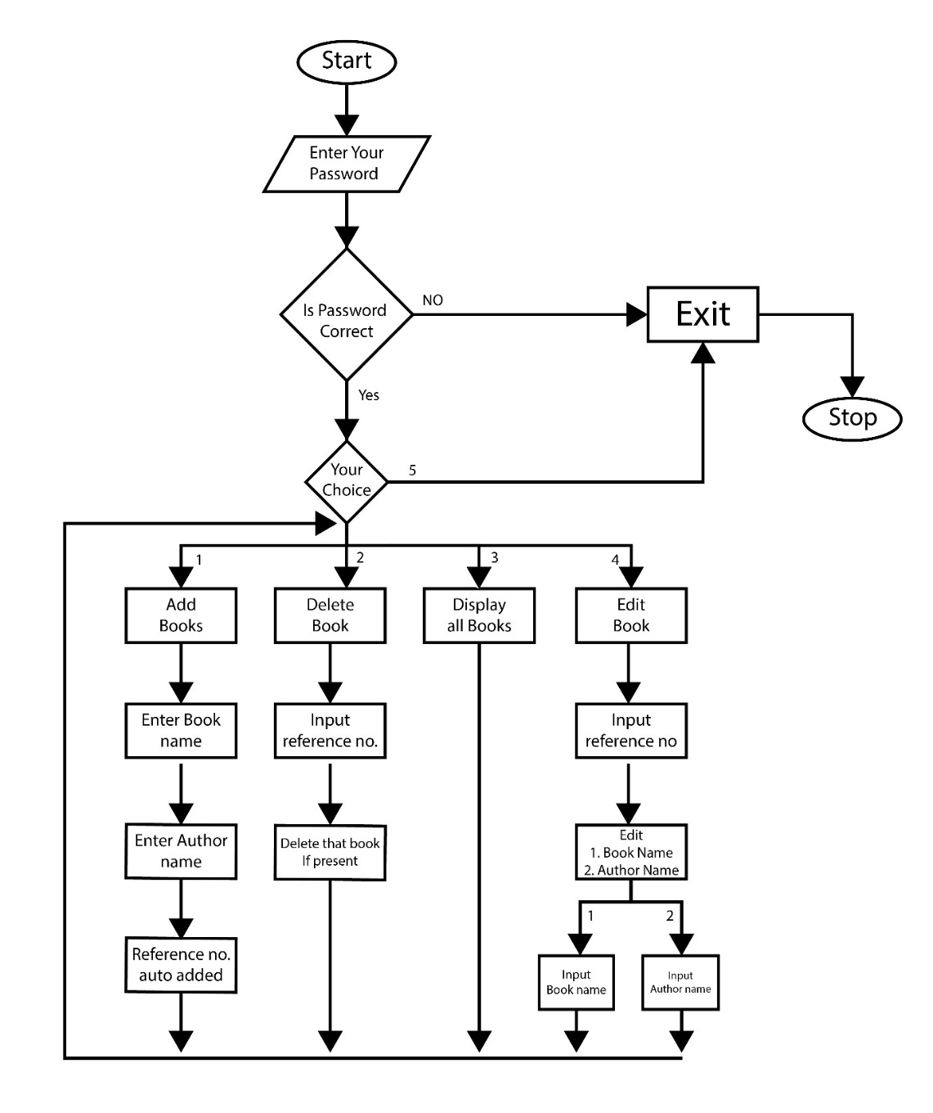
Flow chart

Slide 14
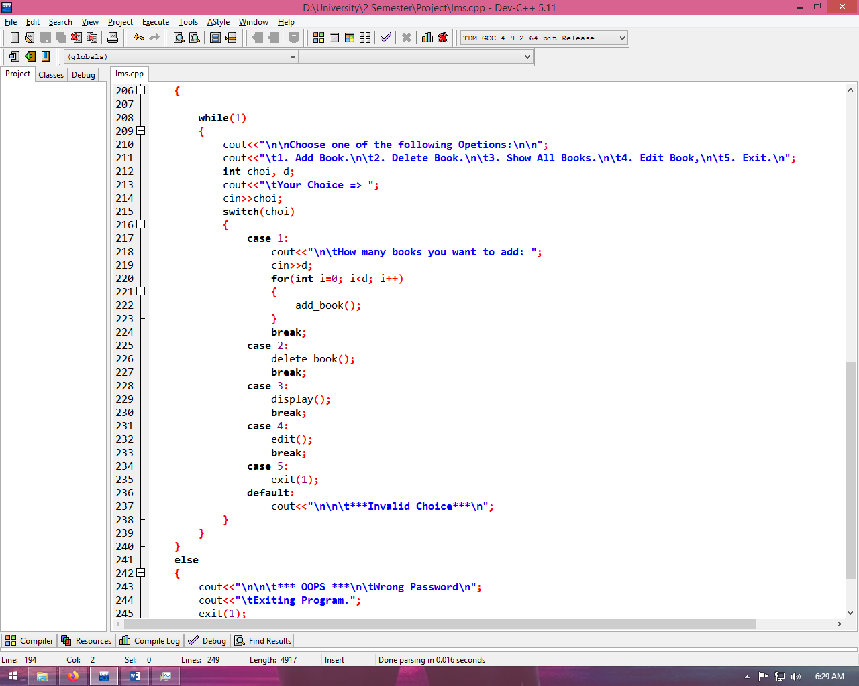
Outputs (1/6)
Code:

Slide 15
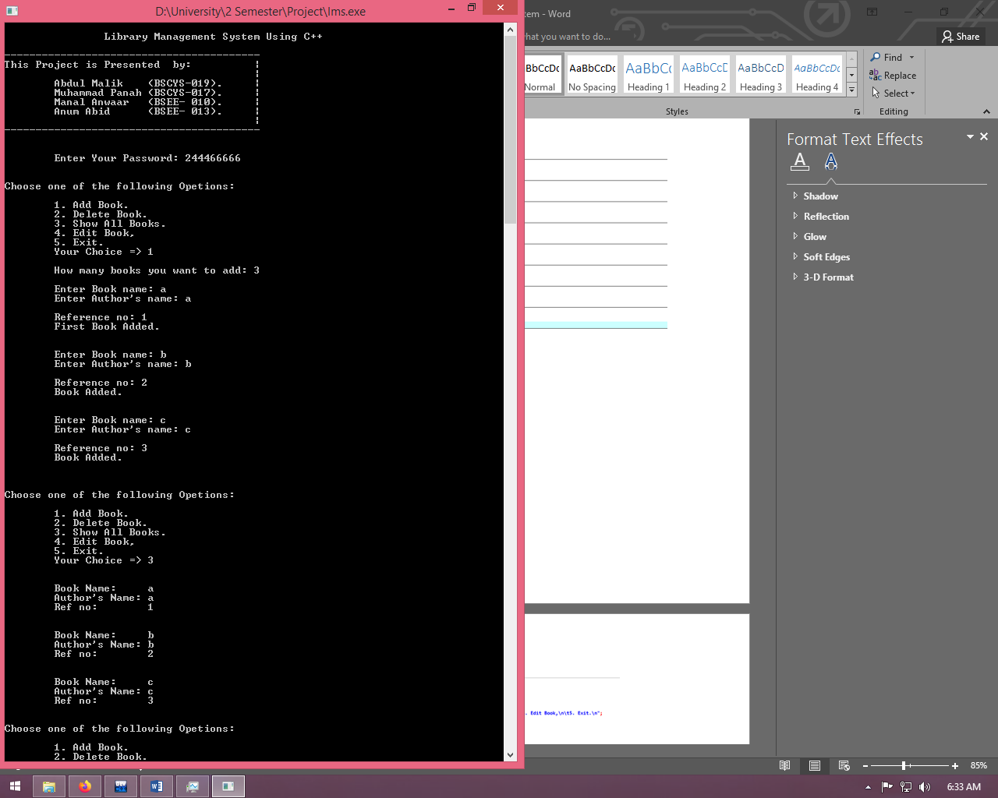
Outputs (2/6)
Main Screen:
It shows Project name
and members who created
this project

Slide 16
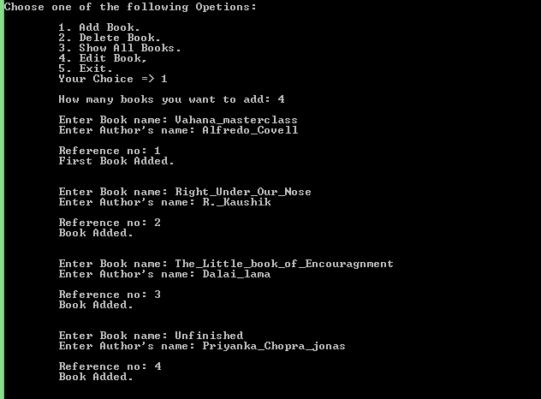
Outputs (3/6)
Add Books:
First it asks How many books you
want to add, then it take input
book name and author name
and reference no is auto generated.

Slide 17
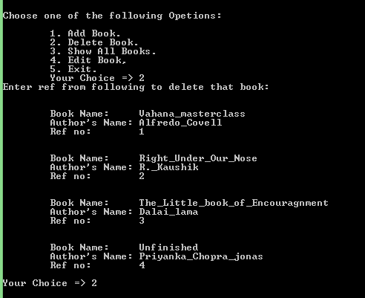
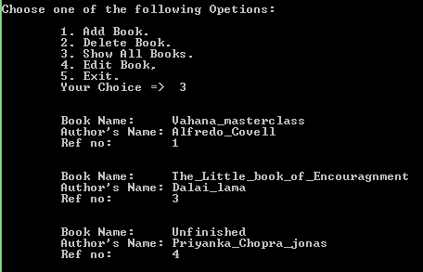
Outputs (4/6)
Deleting a book:
It first asked for reference no of book and then it deletes it.

Slide 18
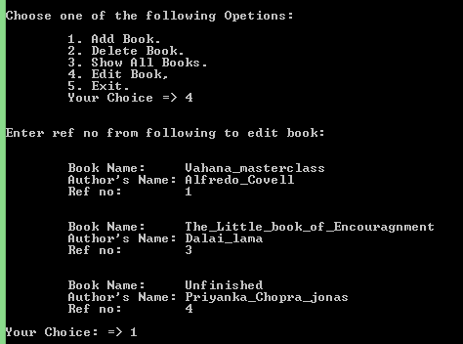
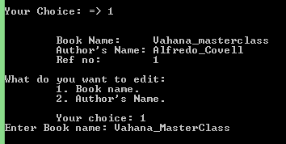
Outputs (5/6)
Editing book:
First asked for ref no, then asks what do you want to edit (Book name or author name)

Slide 19
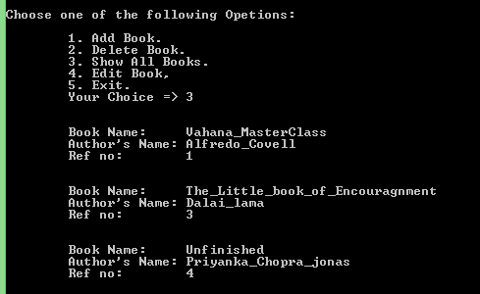
Outputs (6/6)
Displaying all books:

Slide 20
Graph and Histogram

Slide 21
Conclusion
The Library Management System allows the user to store the book details.
This software allows storing the details of all the data related to library books.
The implementation of the system will reduce data entry time and provide readily calculated reports.
The software keeps track of all the info about the books and their complete details.

Slide 22
References
https://www.academia.edu/33632232/LIBRARY_MANAGEMENT_SYSTEM
https://www.slideshare.net/jimmykhan/library-mangement-system-project-srs-documentationdoc
https://www.academia.edu/25553795/Library_Management_system_Problem_and_its_Background_Problem_and_its_Background
https://opentext.wsu.edu/tchlrn445/chapter/chapter-6-supporting-student-problem-solving/
https://www.ashishvegan.com/techvegan/libray-management-system-free-source-code-download.php
https://hbr.org/1985/07/how-information-gives-you-competitive-advantage
https://samphina.com.ng/design-implementation-electronic-library-system/
https://github.com/ulokwevincent/LIBRARY-MANAGEMENT-SYSTEN
https://www.brainspire.com/blog/technology-and-society-how-technology-changed-our-lives
https://www.academia.edu/80060770/The_role_of_the_IHS_library_in_supporting_a_distance_learning_programme_a_practical_assignment_based_on_the_experience_of_the_Institute_for_Housing_and_Urban_Development_Studies_IHS_

Slide 23

FOR LISTENING

Slide 24

Any Questions

